Slide 1

Process Improvement Project With Storyboard
Dan Tully
MBC 638

Slide 2

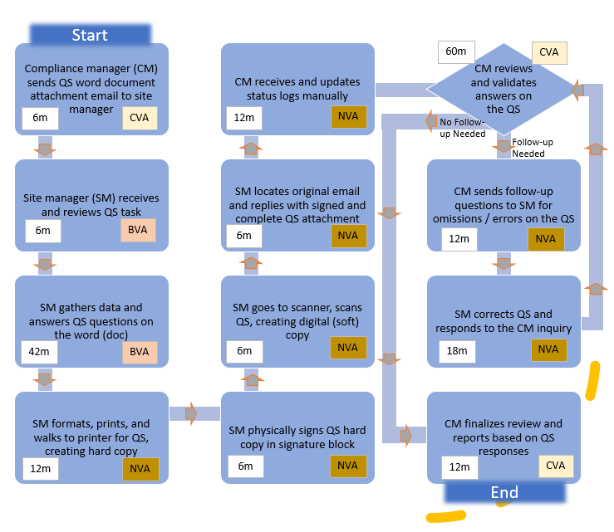
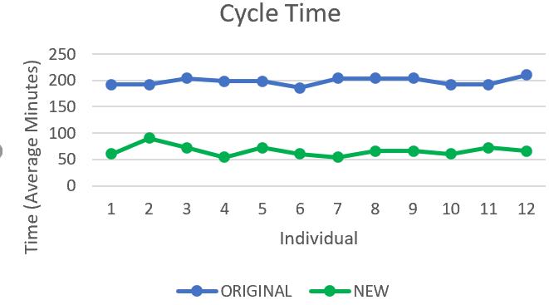
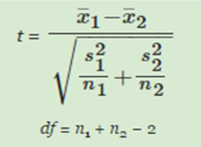
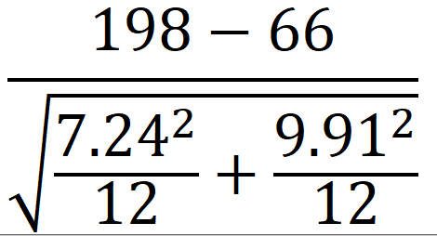
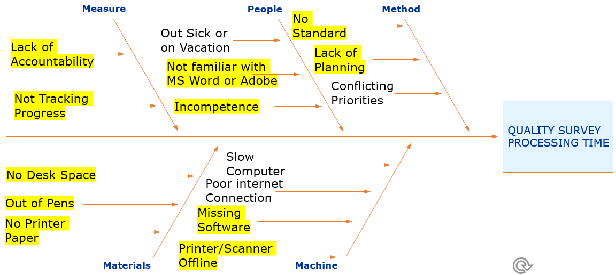
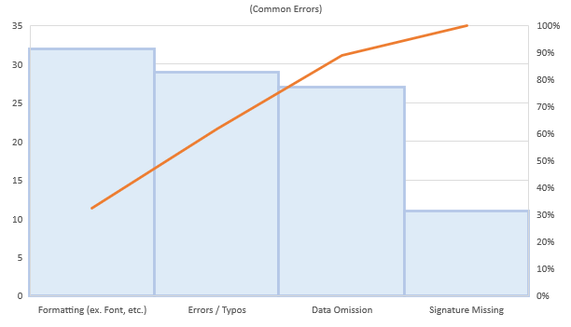
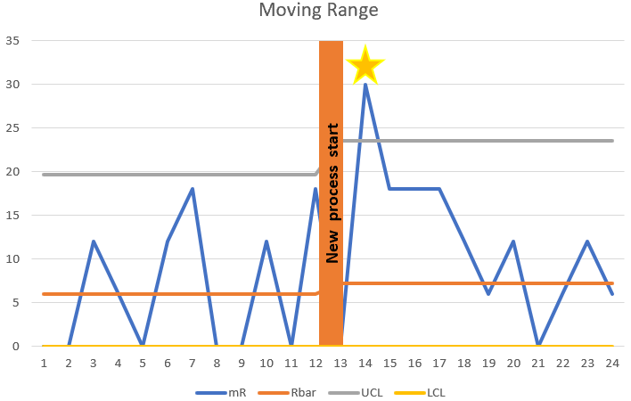
Executive Summary Storyboard
Quality Survey – Cycle Time
Process owner: Dan Tully
Key Dates
Define:
Measure:
Analyze:
Improve:
Control:
October 6
October 20
November 17
November 24
December 6
DEFINE
MEASURE
ANALYZE
IMPROVE
Problem Statement
Cycle time for completing the quality survey averaged 198 minutes. Document formatting, defects and being a predominantly manual process caused major delays and missed deadlines.
Quality Survey Labor Cycle time (Min) | 192 | 204
 | 192 | 204
 | 204 | 204
 | 198 | 192
 | 198 | 192
 | 186 | 210
Mean | 198
Standard Deviation | 7.24
Median | 198
Mode | 192
Eliminate/Reduce time on NVA Steps
SharePoint
Hypothesis Test
H_{o}: µ₁ ≤ µ₂
H_{a}: µ₁ > µ₂
SLOW
High Labor Hrs.
Cycle time reduced to an avg. 66 minutes!
Labor savings avg. 264 hours annually!
Cost savings avg. $13,200 annually!
SQL raised from 1.2 to 3.8!
t=
P-value ≈ 0
SQL = 3.8
NOW
Business Impact
The average labor wage is $50/hr, therefore it costs $165 per Quality survey! At 120 surveys a year this process costs $19,800 annually.
Success
CONTROL
Waste
Eliminate/Reduce Most Common Data Errors
SQL=1.2
WAS
SharePoint standardizes the formatting and eliminates NVA steps (i.e. data omissions) when controls are applied.
User Authentication and tracking in SharePoint.
Easier archiving and data analysis in SharePoint.
Many Possible Causes
Defect Identified -
Follow-up Required
TEAM MEMBERS
Dan, Site Property Managers, and Stakeholders

Slide 3

PROBLEM STATEMENT
As a compliance manager, one of the tools used by the department is a Quality Survey (QS). The QS is in Microsoft Word and has no distinct formatting presets or standards. The QS is sent out to the site managers via email attachment. The QS requires a signature of the individual completing the form which is probably why responses are returned in a variation of file format types (.docx, .doc, .pdf, etc.). Font (size, color, underlining, etc.) variations, data omission and questions incorrectly interpreted are also a problem on this QS. Overall, the document is manually archived, manually reviewed, manually validated, and manually referenced against other data sources. Tracking and progress reporting on the received/completed QS is also done manually. Ultimately, this process results in missed deadlines and poor-quality responses.

Slide 4



SCOPE
GOAL
My improvement objectives consist of standardizing the formatting to fully eliminate variations in types of documents returned and the wasted time formatting text. Create a delivery method that reduces the required process steps by at least 40%. Guarantee basic requirements are met by eliminating the need to manually evaluate and validate data completeness on the QS. Finally, I will eliminate the manual progress tracking status log for the QS.
BUSINESS IMPACT
Site managers spend wasteful time worrying about text formatting and document type formatting for the QS. After they format the document in Microsoft Word, they mostly print it, sign it, scan it, and then attach that scanned file (generally PDF) on to an email they compose back to the compliance manager. Eliminating all these wasteful steps will significantly improve the cycle time process efficiency and decreasing cost and schedule. This project is estimated to save over $10,000 annually by removing the unnecessary steps in this QS reporting process.
I am focusing this improvement review on the process delivery and evaluation (completeness) of the QS. The quality evaluation (or accuracy) of data returned will not be included in the evaluation. The usefulness of the QS will not be part of this evaluation, I am strictly reviewing the delivery process, tracking and the data completeness in the QS process.

Slide 5


TEAM
I am the process owner and champion for this process. I will work with the site managers (or designee) to analyze and/or impact this process.
SCHEDULE
Define: October 6, 2020
Measure: October 20, 2020
Analyze: November 17, 2020
Improve: November 24, 2020
Control: December 6, 2020

Slide 6

PROCESS MAP (CYCLE-TIME)
Start
Compliance manager (CM) sends QS word document attachment email to site manager
CM receives and updates status logs manually
60m
CVA
CM reviews and validates answers on the QS
6m
CVA
12m
NVA
No Follow-up Needed
Follow-up
Needed
Site manager (SM) receives and reviews QS task
SM locates original email and replies with signed and complete QS attachment
CM sends follow-up questions to SM for omissions / errors on the QS
6m
BVA
6m
NVA
12m
NVA
SM gathers data and answers QS questions on the word (doc)
SM goes to scanner, scans QS, creating digital (soft) copy
SM corrects QS and responds to the CM inquiry
KEY
(CVA) | Customer Value Add
(BVA) | Business Value Add
(NVA) | No Value Add
Min | Avg. Minutes (Time*)
 | Eliminated or Reduce Time
42m
BVA
6m
NVA
18m
NVA
CVA
BVA
SM formats, prints, and walks to printer for QS, creating hard copy
SM physically signs QS hard copy in signature block
CM finalizes review and reports based on QS responses
NVA
6m
Continuous Data
12m
NVA
6m
NVA
12m
CVA
End
*Note: time is recorded in 6 min intervals because that is how time is recorded at my job.

Slide 7
CAUSES OF QUALITY SURVEY PROCESSING TIME
Measure
People
Method
No Standard
Out Sick or on Vacation
Lack of Accountability
Lack of Planning
Not familiar with MS Word or Adobe
Conflicting Priorities
Not Tracking Progress
Incompetence
QUALITY SURVEY
PROCESSING TIME
Slow
Computer
No Desk Space
Poor internet
Connection
Out of Pens
Missing Software
HIGHLIGHTED areas impacted /addressed in this project. The other areas this project has little direct influence over.
No Printer Paper
Printer/Scanner Offline
Materials
Machine

Slide 8

DATA MEASUREMENT PLAN
Performance Measurement | Data Source and Location | How Will Data Be Collected | Who will Collect Data | When Will Data Be Collected | Target Sample Size
Record No. of QS report defects – Prior | QS Rpts/File | Manual collection | Dan | 10/20 | 30 QS Rpt
Record No. of QS report defects – Now | QS Rpts/SP | Pulled from report | Dan | 11/24 | 20 QS Rpt
% On time reporting | QS Rpts/SP | Pulled from report | Dan | 11/24 | 30 QS Rpt
No. of minutes required to process QS – Prior | Survey/Excel | Manual collection | Dan | 10/20 | 12 QS Rpt
No. of minutes required to process QS – Now | Survey/Excel | Manual collection | Dan | 11/24 | 12 QS Rpt
% of process map steps eliminated | Process Map | Manual collection | Dan | 12/04 | N/A
User satisfaction with new process | Survey/SP | Manual collection | Dan | 01/15/21 | TBD

Slide 9

OPERATIONAL DEFINITION
Defect Variable | Operational Definition
Formatting | The answers were not in a consistent format or if money was missing currency identifier ($). Also, if any special coloring or other then the default fonts were applied.
Errors | The responses are not answering the question asked or if calculations were incorrect.
Data Omission | The questions are not answered.
Signature Missing | The signature (Electronic certificate or handwritten) is not provided.

Slide 10
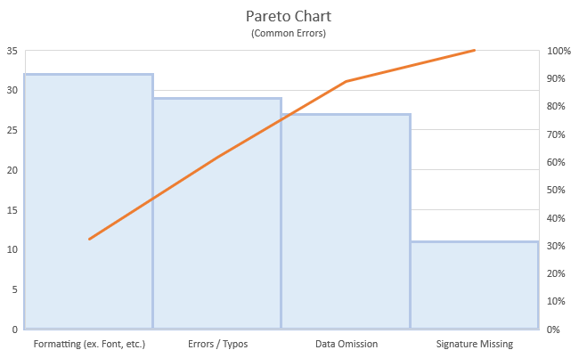
Measure QS Defects
After reviewing a population of 40 previously reported QS, I was able to identify 4 common defects with the process. I counted the occurrences of this discrete data and plotted them in this Pareto chart. Formatting and Errors were the most common problems while data and signature omissions were also noteworthy.
Defects
Mean | 2.475
Standard Error | 0.164034
Median | 3
Mode | 3
Standard Deviation | 1.03744
Sample Variance | 1.076282
Kurtosis | -1.12737
Skewness | -0.07497
Range | 3
Minimum | 1
Maximum | 4
Sum | 99
Count | 40
Calculated SQL = 1.2
1. Defect opportunities per unit: D = 4
2. Units produced: U = 40
3. Total possible defects: D × U = 160
4. Total actual defects: A = 99
5. Defect per opportunity rate: A ÷ DU = 0.6188(DPO) X 100= 61.9%
6. Defects per million opportunities (DPMO): DPO × 1,000,000 = 618800
7. SQL value (from SQL table): 1.2

Slide 11

HYPOTHESIS STATEMENTS
NULL (Ho): Average current cycle time (µ₁) is less than or equal to (≤) the average new cycle time (µ₂).
ALTERNATIVE (Ha): Average current cycle time (µ₁) is greater than (>) the average new cycle time (µ₂). I want to improved/reduce the survey cycle time by reducing defects and eliminate unnecessary steps in the process.

Slide 12
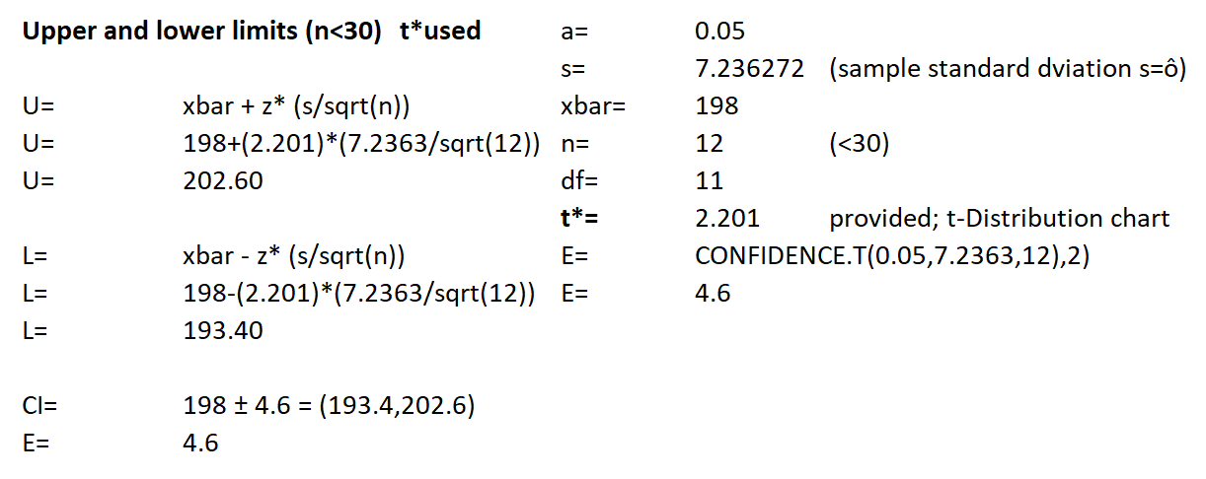
SAMPLE SIZE AND CONFIDENCE INTERVAL CALCULATIONS
ORIGINAL Cycle time (Min)
n= | (z*o/E)^2 |  |  | z*= | 1.96
n= | (((1.96)*(7.23627226986633))/4.6)^2 |  |  | ô= | 7.23627227
n= | 9.50662 | ≈ | 10 | E= | 4.600
To reduce the Margin of Error (E) Sample size (n) needs to be increased.
Confidence Interval is:
198 ± 4.6

Slide 13
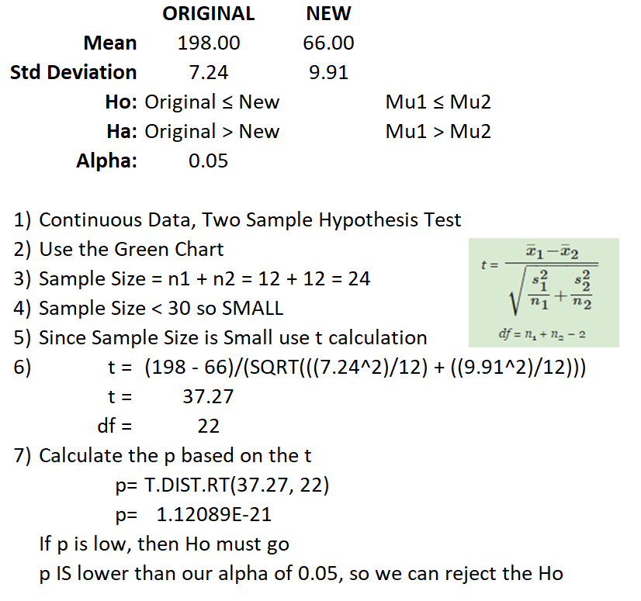
HYPOTHESIS TEST RESULTS
Averaging the continuous data, process cycle time, in minutes, before the process change (Original) and then after (New). As we review this data at the conclusion of this test, we discover the very low p score and reject Ho. The conclusion is that our process time has a relationship (Ha) to the reduced defects and eliminated steps in our process.
DATA | ORIGINAL | NEW
 | Cycle time (Min) | Cycle time (Min)
# (n) | Processing Time | Processing Time
1 | 192 | 60
2 | 192 | 90
3 | 204 | 72
4 | 198 | 54
5 | 198 | 72
6 | 186 | 60
7 | 204 | 54
8 | 204 | 66
9 | 204 | 66
10 | 192 | 60
11 | 192 | 72
12 | 210 | 66

Slide 14
CONTROL CHARTS & SIGMA QUALITY LEVEL
Implemented the Individuals Moving Range (ImR) chart to evaluate my new process. I will have to follow up on one of the responses ( ) to see if there was an operational definitions issue with the request. The respondent may have had a calculation issue or may need additional training on the new process.
New SQL
1. Defect opportunities per unit: D = 4
2. Units produced: U = 24
3. Total possible defects: D × U = 96
4. Total actual defects: A = 1
5. DPO: A ÷ DU = 0.0104(DPO) X 100= 1%
6. DPMO: DPO × 1,000,000 = 10400
7. SQL value (from SQL table): 3.8
= possible problem with new process and/or additional training may be needed.

Slide 15

Summary
Define
Cycle time for completing the quality survey averaged 198 minutes. Document formatting, defects and being a predominantly manual process caused major delays and missed deadlines.
Measure
Examining the process map and fishbone diagram helped identify, sort and display the multiple areas to improve.
Collected my cycle time data.
Analyze
Reviewed the past performance defects.
Determined my sample size and confidence interval.
Improve
Using SharePoint eliminates and/or reduces the time for all the NVA steps in my process map.
Control
With our new process we will enjoy the reduced time it takes to complete the survey.
We can further evaluate the usefulness and accuracy of the discrete data provided in the survey.

